Slide 1

DU Senior Capstone: Reddit Analytics
By: Isaiah Erb, Greg Marino, Sondor Bayarbat, Darlen Castro

Slide 2
Agenda
Technology Stack and Database Schema
Dashboard
Recommendations
Improvements and Links
Key Benefits

Slide 3








Technology Stack
Extract
Transform
Load

Slide 4
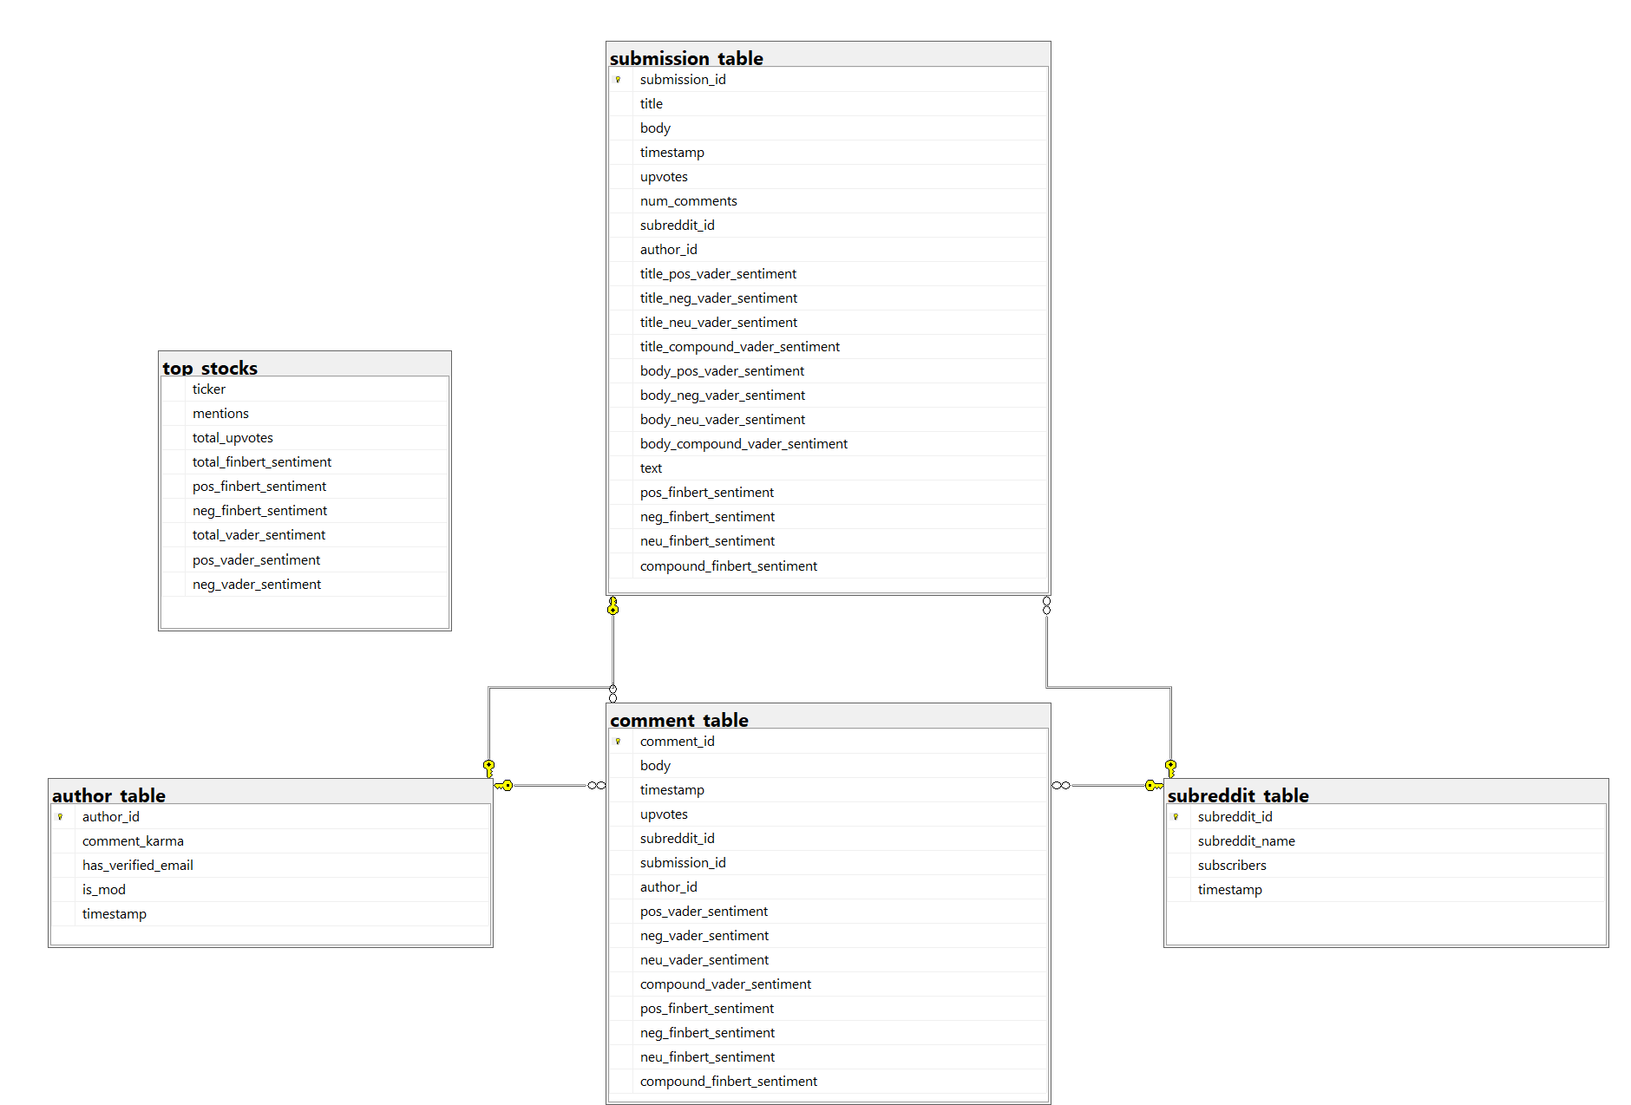
Database Schema

Slide 5

Key Benefits
SQL Server database
13 subreddits, 200k+ submissions and comments
Update existing database and load in new subreddits with Python
Sentiment Analysis
VADER lexicon
FinBERT (Google)
Power BI (drill-through, search, filtering, hovering)

Slide 6
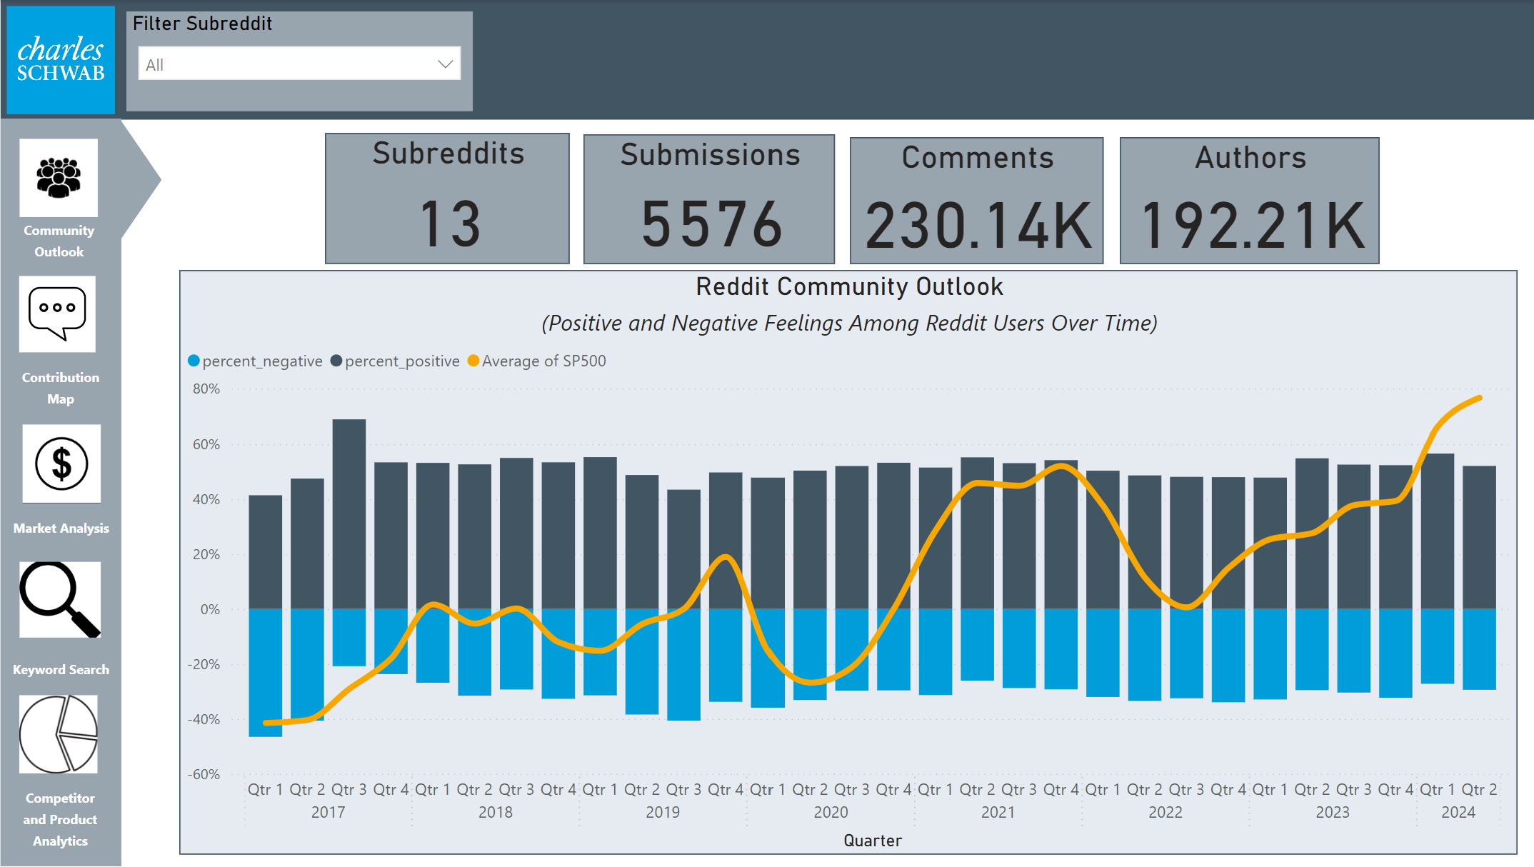

Slide 7
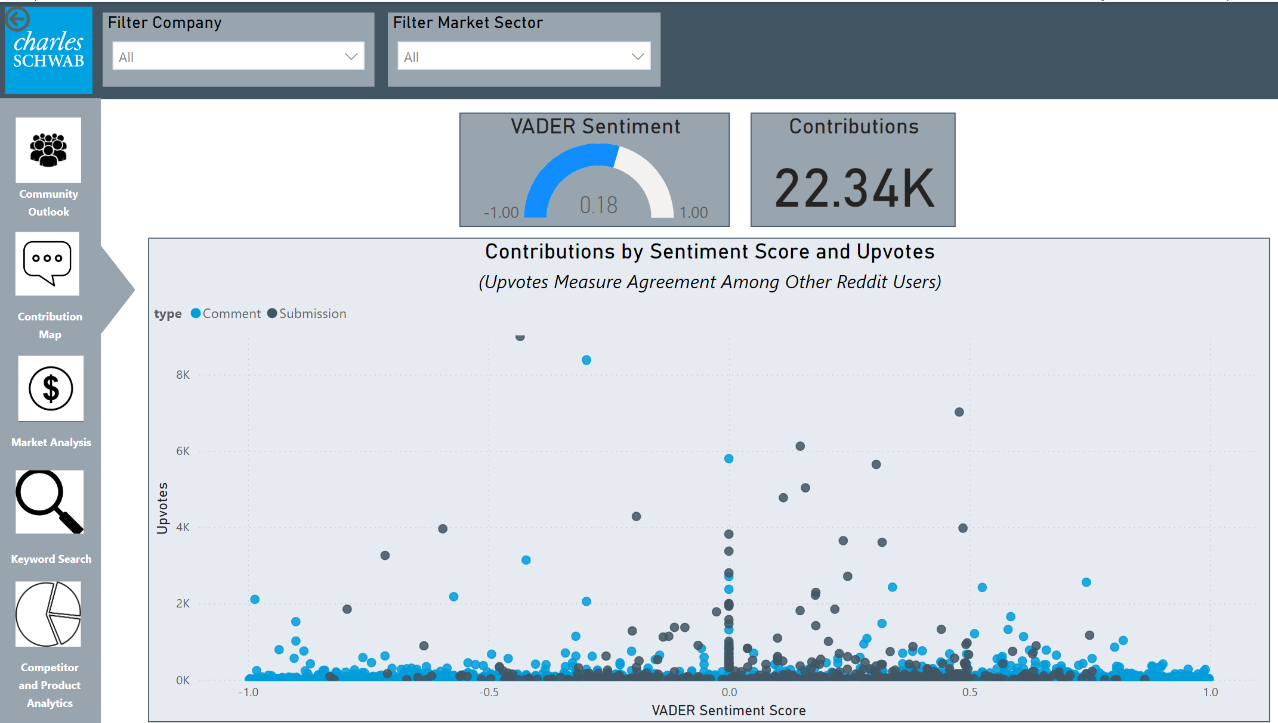

Slide 8
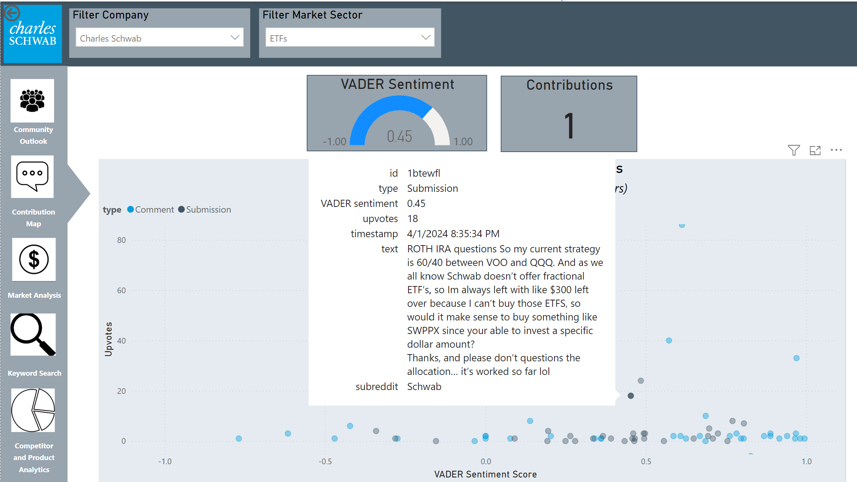

Slide 9
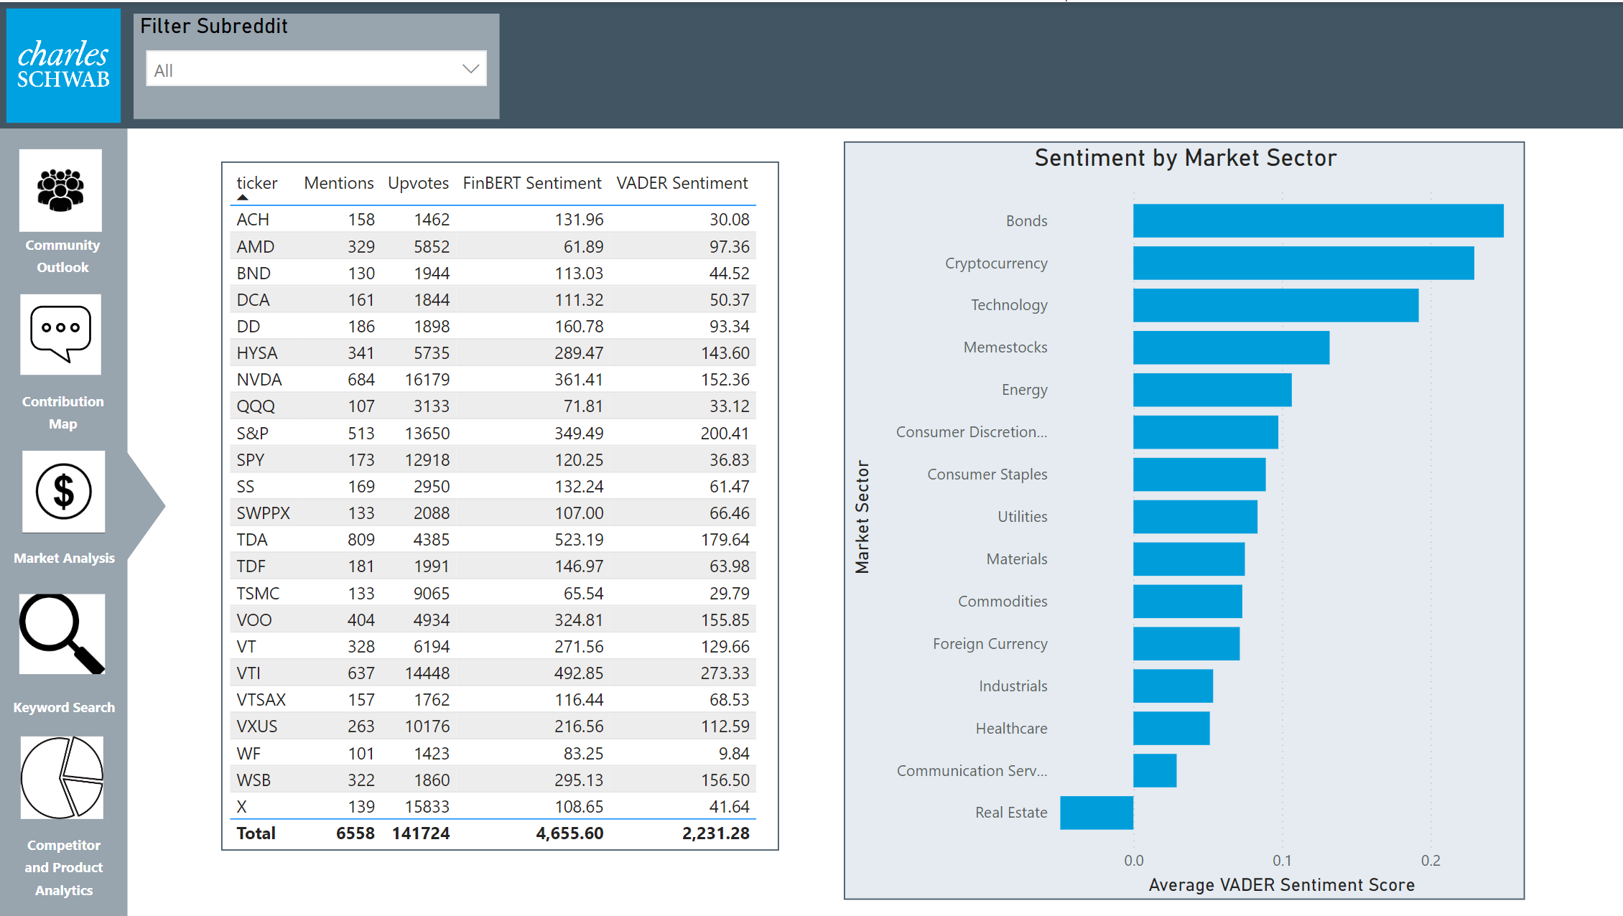

Slide 10
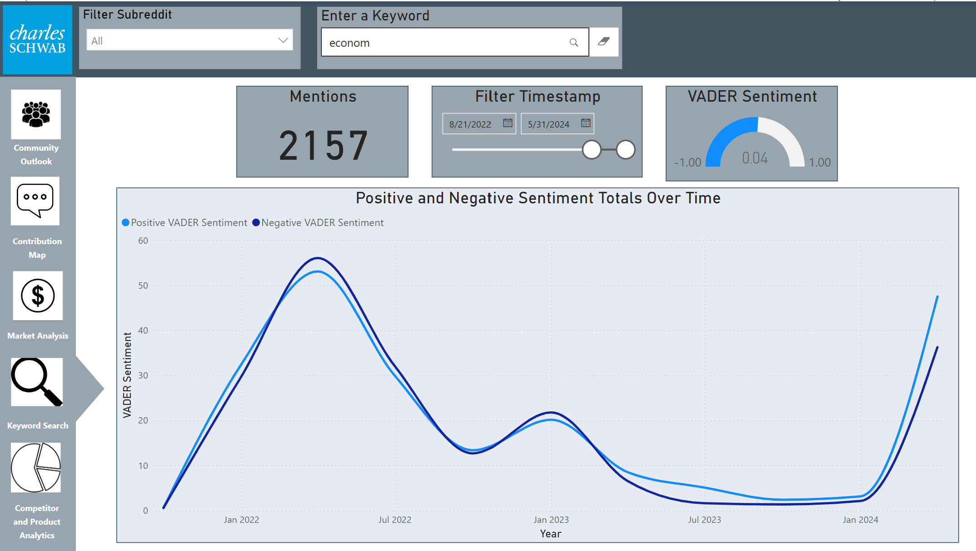

Slide 11
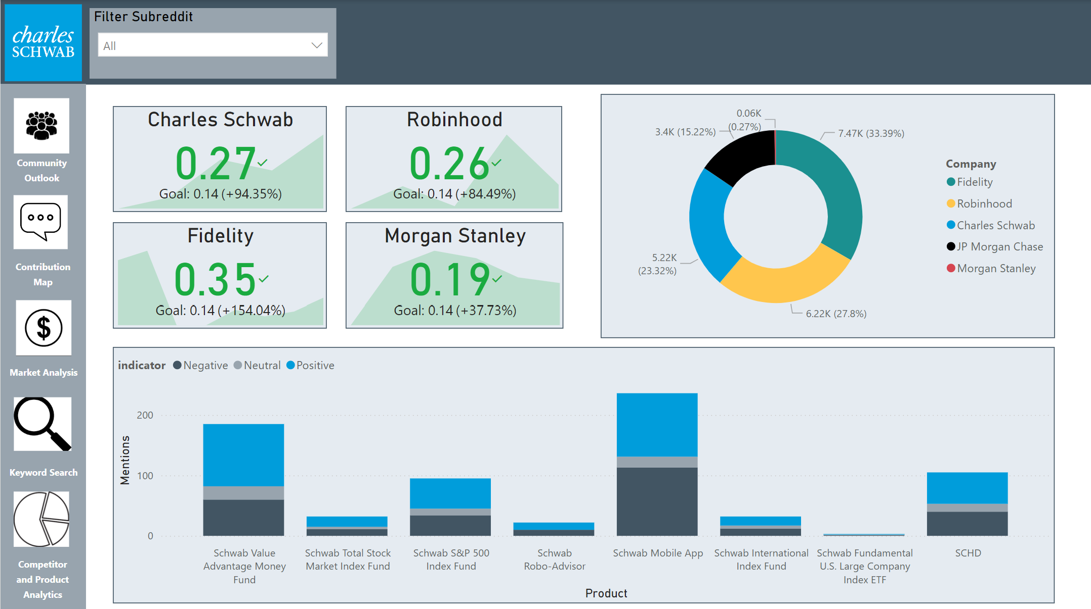

Slide 12

Recommendations
Ask Me Anything
Ease tensions with retail traders
Receive feedback from existing customers
Attract future customers
Communities
r/SuperStonk and r/wallstreetbets - retail
r/Schwab and r/thinkorswim - customers
r/investing and r/Bogleheads - prospects
r/Schwaben and r/PersonalFinanceCanada - foreign

Slide 13
Improvements and Links
Power BI speed
Reducing dataset size
Switching to Tableau or streamlit
Data collection
YouTube
Online Forums
NYT API
Social Media
Translator for subreddit communities in different languages
Links
https://github.com/isaiaherb/reddit
https://hub.docker.com/repository/docker/isaiaherb9264/reddit-charles-schwab/general

Slide 14
Thank You!

Slide 15
Subreddit List
Subreddits in our database:
Schwab
CharlesSchwab
FidelityInvestments
Robinhood
Wallstreetbets
Bogleheads
Investing
Algotrading
Banking
StockMarket
Stocks
Tdameritrade
Thinkorswim

